Slide 1

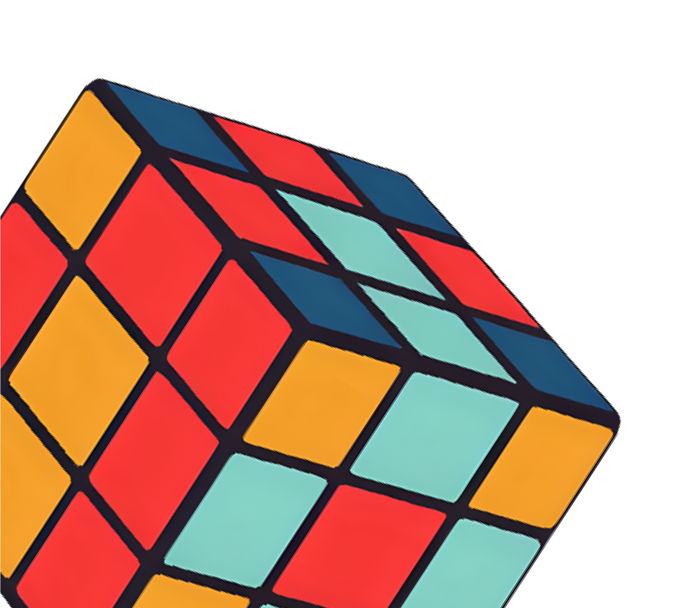
Cube Mind – Rubik’s Cube Solver

Slide 2




Team Members
Supervisor
Dr. Tareq Zanoon
Ahmad khaldy
Mohammad Atiyeh
Loai Hamamdeh
Students

Slide 3
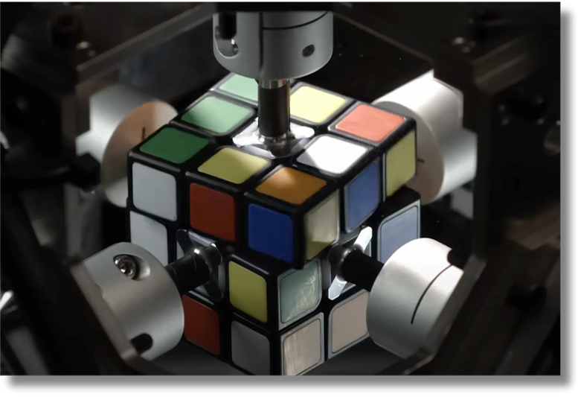

The Rubik's Cube is a 3D puzzle that has intrigued and challenged minds for decades. Behind its colorful and seemingly simple exterior lies a highly complex combinatorial problem .
INTRODUCTION

Slide 4


In our project, we bring this challenge into the domain of computer systems engineering by designing and building an autonomous robot that can solve the Rubik's Cube without human intervention. This involves integrating advanced computer vision, embedded systems programming, robotic manipulation, and algorithmic optimization.
INTRODUCTION

Slide 5
Our robot, "Cube Mind," shows how the theoretical knowledge we gained in our studies can become a practical, working system. It is not just a puzzle solver. It demonstrates engineering teamwork, problem-solving, and innovation.
INTRODUCTION

Slide 6







FEATURES
High color detection accuracy under real conditions (≥95%)
Autonomous Rubik’s Cube solving from scan to execution
Real-time motor control and response
Solve the cube in a short time of 30 seconds or less
Python + OpenCV + Kociemba solver integration

Slide 7
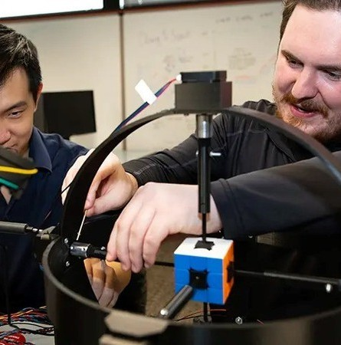
Project Objectives
Build a full hardware/software embedded system

Slide 8

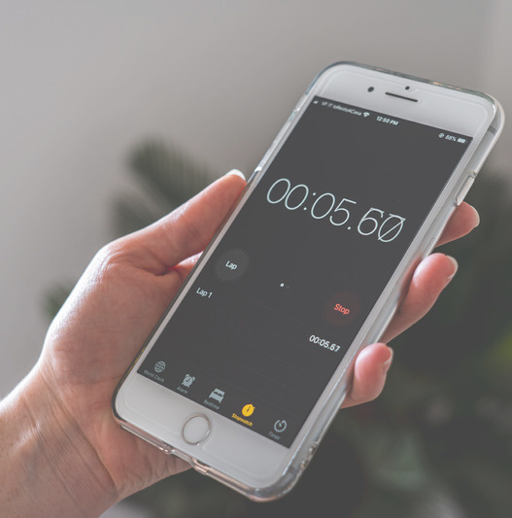
Project Objectives
Solve the cube in <= 30 seconds

Slide 9
Project Objectives
❌ Failed Solves 10%
≥ 90% success rate across 20 trials
✅ Successful Solves 90%

Slide 10

Project Objectives
Color detection accuracy ≥ 95%

Slide 11
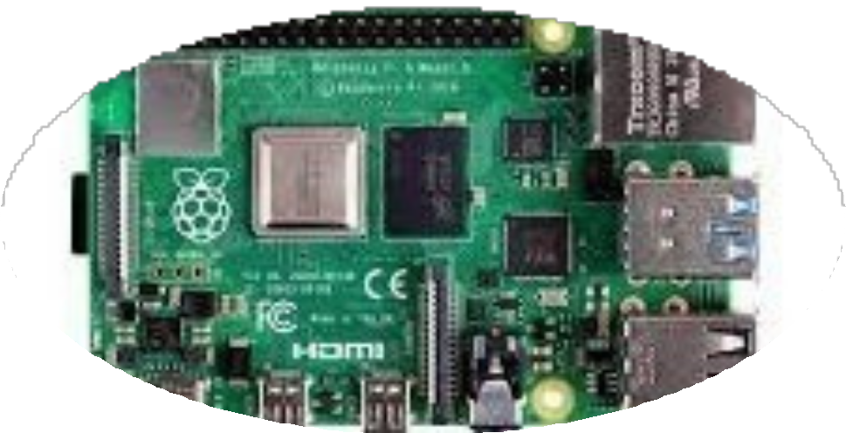
Hardware Design
Raspberry Pi 4 : Central processing unit

Slide 12
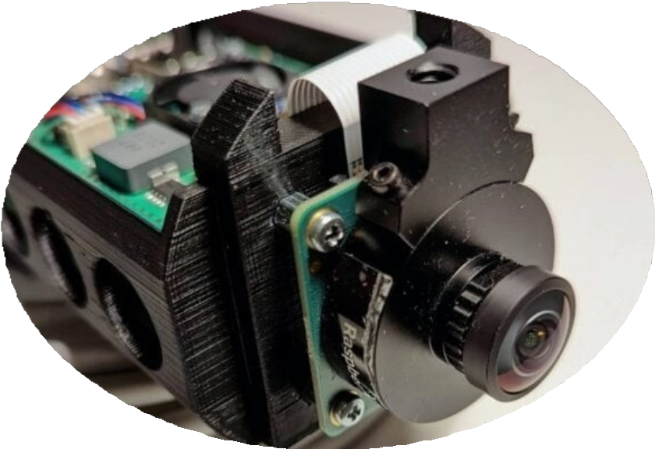
Hardware Design
USB Cameras : Capture images

Slide 13
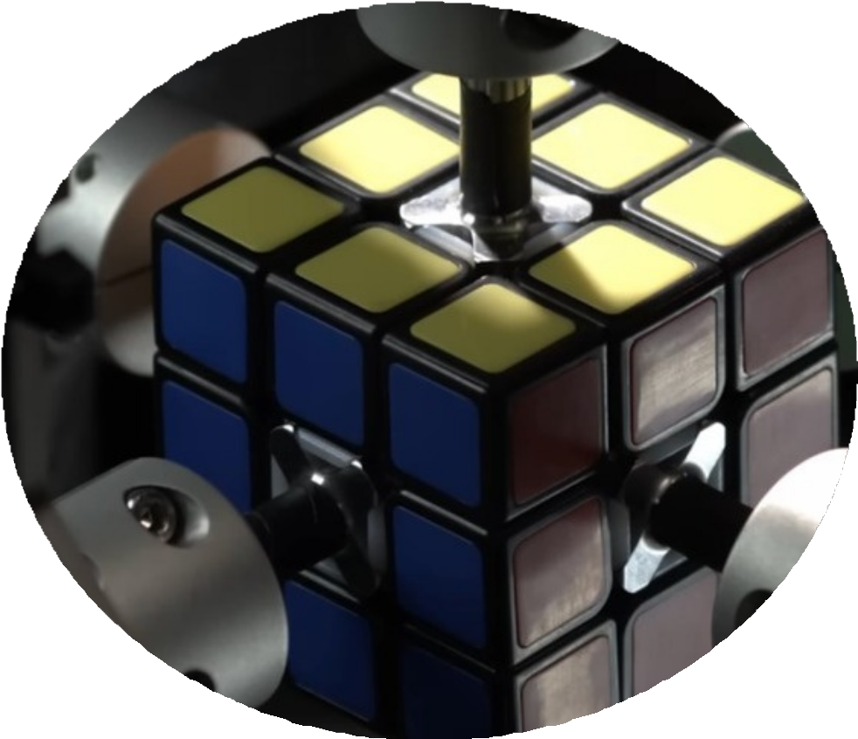
Hardware Design
Servo Motors :Control cube face rotations

Slide 14
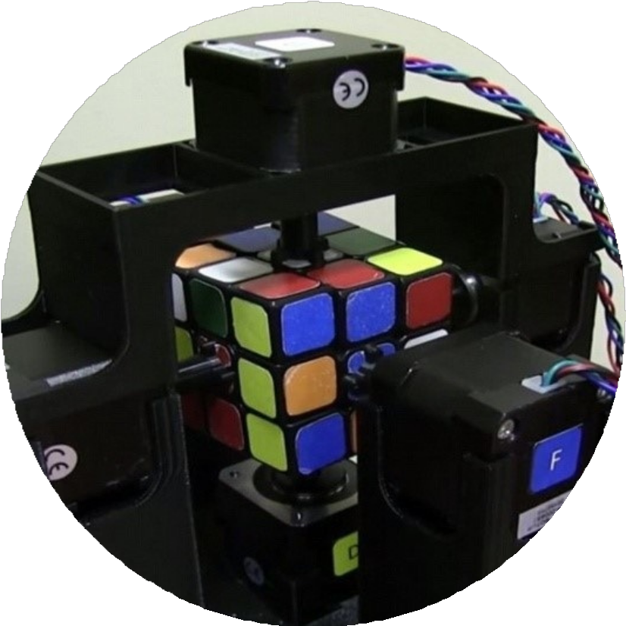
Hardware Design
Custom Base and Grippers : Holds the cube

Slide 15

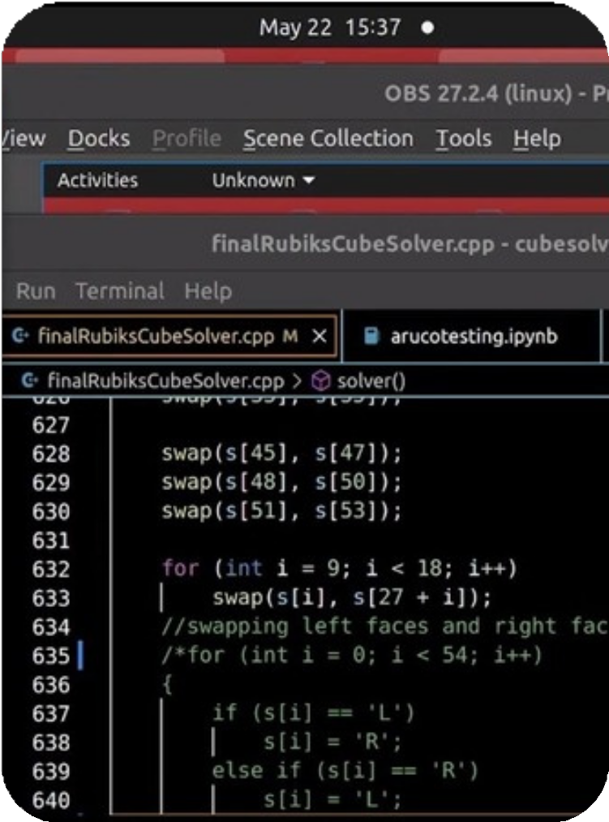
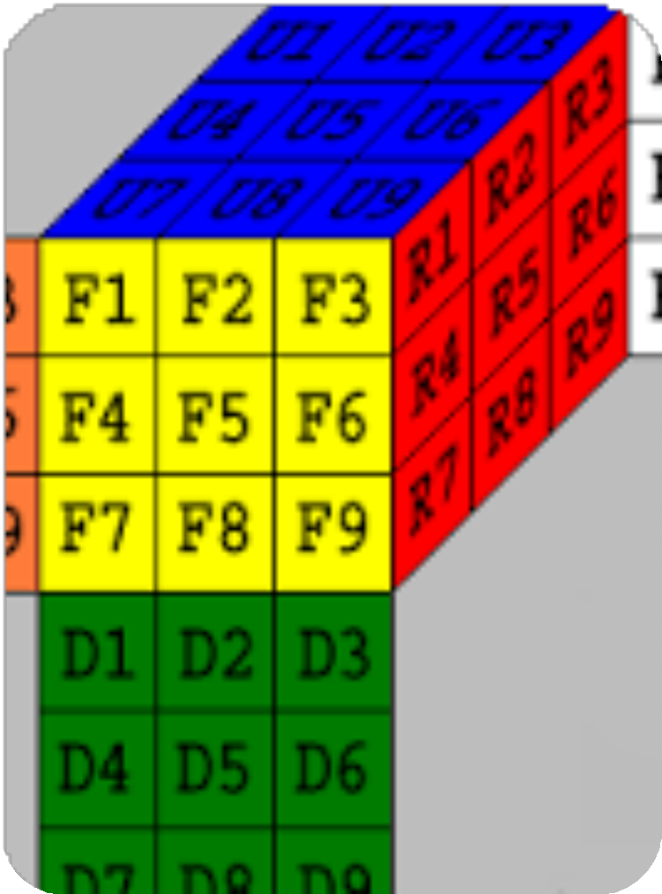
SOFTWARE DESIGN
Kociemba's algorithm:
The Rubik's Cube can be solved from any jumbled state by using the Kociemba algorithm to determine an effective and ideal series of moves.
Python + OpenCV (for color detection).

Slide 16
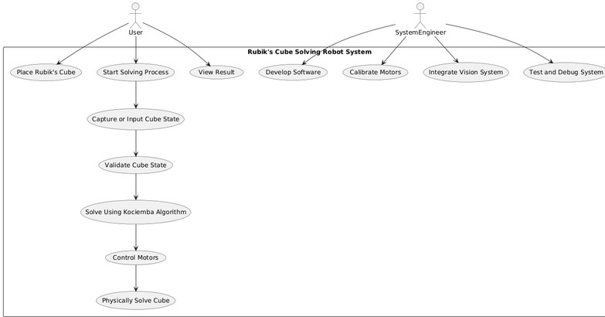
use case diagram

Slide 17

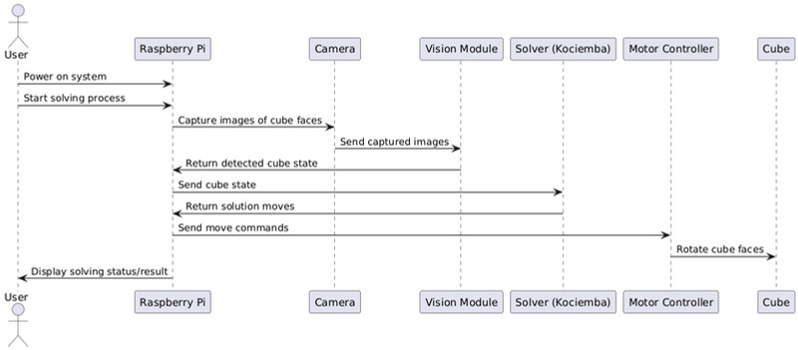
METHODOLOGY
01
Initialize System
02
Capture Images from All Faces
03
Detect Colors & Map State
04
Solve with Kociemba
05
Execute Moves with Servo Motors

Slide 18
Related Work
Project
Method
Hardware
Time
Advantage
AI Solver
CNN/BFS
Simulated
Slow
Physical robot
DeepCubeA
RL + A*
Theoretical
20 moves
Our system is real
CubeMaster
CFOP/DFS
Arduino
40 sec
Faster, simpler setup

Slide 19
Challenges & Solutions
Challenge
Color accuracy
Solution
Calibrated OpenCV + Lighting
Cube gripping
3D Printed base & fine control
Arduino limits
Raspberry Pi used
Cost
Reduced cameras from 6 to 2

Slide 20






Conclusion
"Cube Mind" provides a hands-on example of how computer systems engineering can address practical issues. Using Kociemba's algorithm, computer vision, and embedded systems, we were able to create a robot that can solve a 3x3 Rubik's Cube on its own.
The project demonstrated excellent color detection and motor control performance and validated our technical decisions. It displays creative problem-solving, efficient teamwork, and applied engineering abilities.
Our goals for Senior Project II are to increase the robot's speed, accuracy, and capabilities.

Slide 21
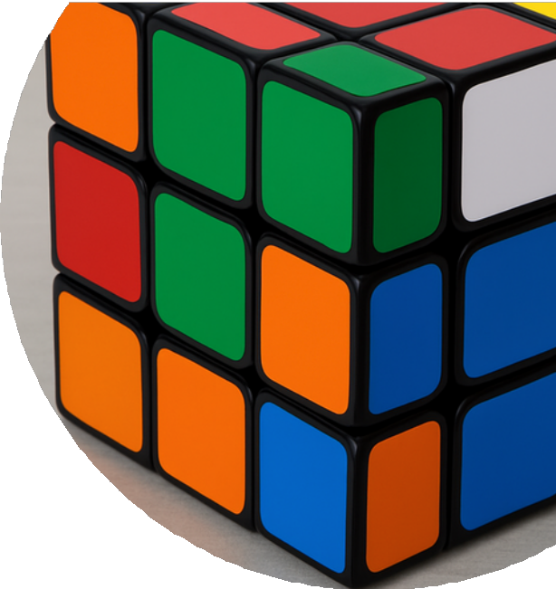



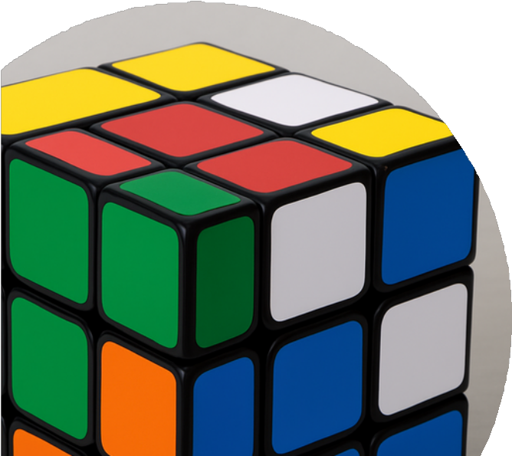


Thank you
Questions?

